Slide 1
Week 2
MHarnesses

Slide 2
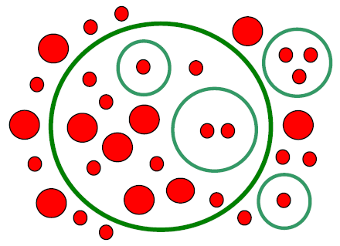
Intro: What is MHARNESS?
Multi-conductor, Multi-shield, Multi-branched transmission line.
Shown in the corner are Shields and Wires.
As illustrated, presently only two levels of embedded layers are permitted.

Slide 3

Impedance Matrices and Parameters
Identified by $\vec{G}, \vec{R}, \vec{C}, \vec{L}$.
For a line with n conductors, these parameters become $n×n$ matrices.
$\vec{G}, \vec{C}, \vec{L}$ are full matrices, while $\vec{R}$is diagonal matrix.

